Slide 1



Verification of Translation Model Transformations
Levi Lúcio†, Bentley James Oakes, and Hans Vangheluwe†,‡
†School of Computer Science, McGill University, Montreal, Canada
‡Department of Mathematics and Computer Science, University of Antwerp, Belgium
{levi,hv}@cs.mcgill.ca, bentley.oakes@mail.mcgill.ca
March 2, 2015

Slide 2
Problem Statement
We want to prove pre- post- condition structural, properties of a translation model transformation, for all its executions.
The infinite amount of transformation executions implies the proof needs to be done on a finite abstraction of the transformation’s executions.

Slide 3
Problem Statement
How can we build this abstraction mechanically and use it to prove properties?
Does the technique scale?

Slide 4
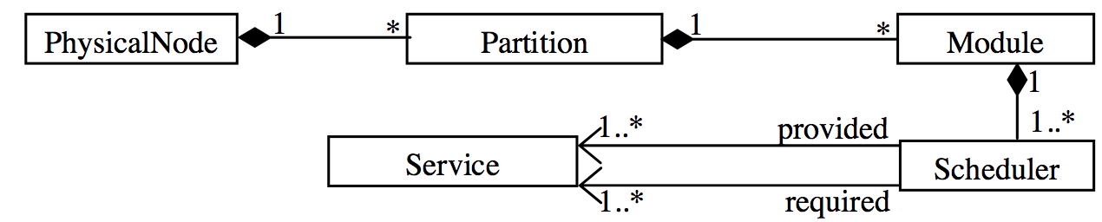
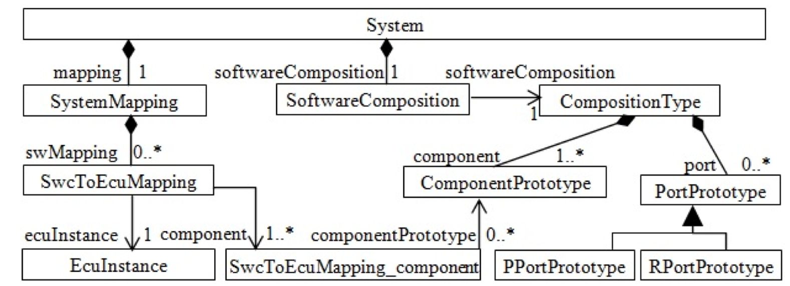
VCS to AUTOSAR Transformation [1]
VCS Metamodel (obfuscated fragment)
AUTOSAR Metamodel (fragment)
[1] G. Selim, S. Wang, J. R. Cordy, J. Dingel. “Model Transformations for Migrating Legacy Models:
An Industrial Case Study”. ECMFA 2012, Lyngby, Denmark (LNCS)

Slide 5
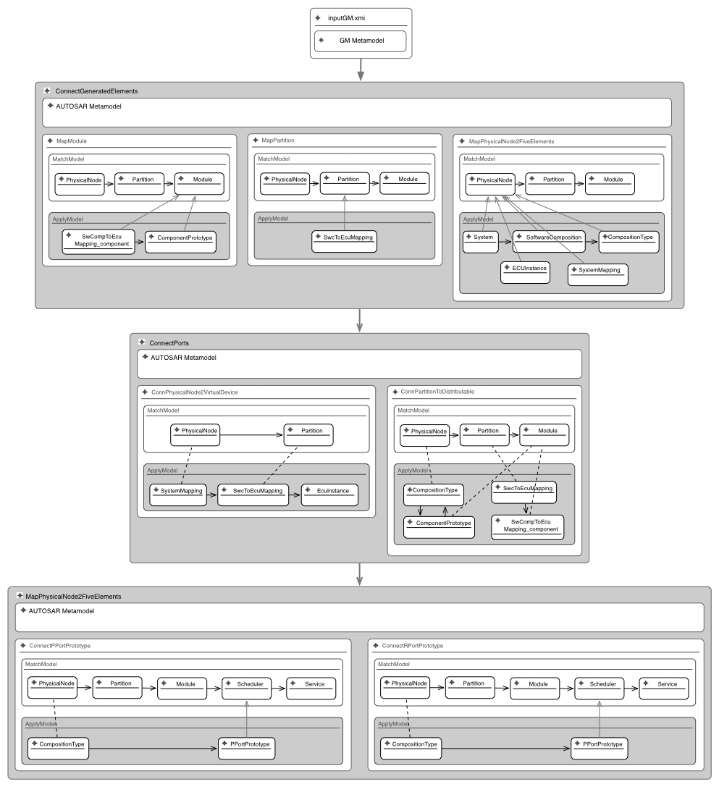
Migrating Legacy Models from VCS to AUTOSAR in DSLTrans [2]
Layer 1
Layer 2
Layer 3
[2] DSLTrans: A Turing Incomplete Transformation Language, B. Barroca, L. Lúcio, V. Amaral R. Félix, V. Sousa. Proceedings of SLE 2010, Eindhoven, Netherlands, 2010.
Notes:
DSLTrans is made only for translations
Termination and confluence by construction
Expressiveness Reduction
I will speak on more length about DSLTrans transformations on friday

Slide 6
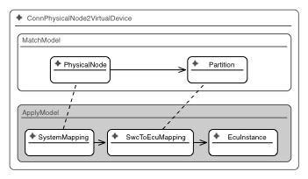
DSLTrans Rule Detail

Slide 7
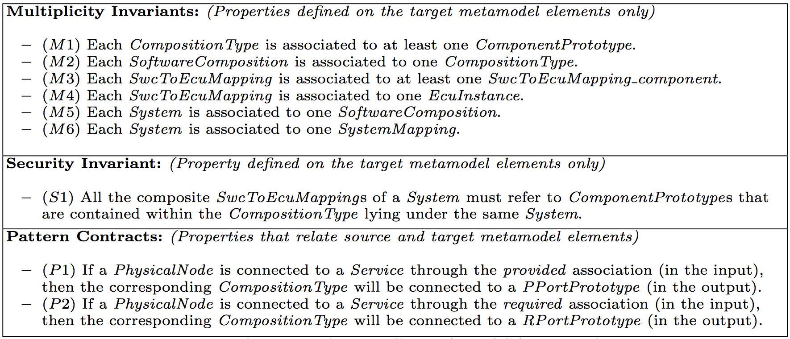
Requirements [3] for the migration transformation from General Motors
[3] G. Selim, S. Wang, J. R. Cordy, J. Dingel. “Model Transformations for Migrating Legacy Models:
An Industrial Case Study”. ECMFA 2012, Lyngby, Denmark (LNCS)
Notes:
Structural requirements, as done in the mathworks for flatenning transformations
Classes of properties

Slide 8
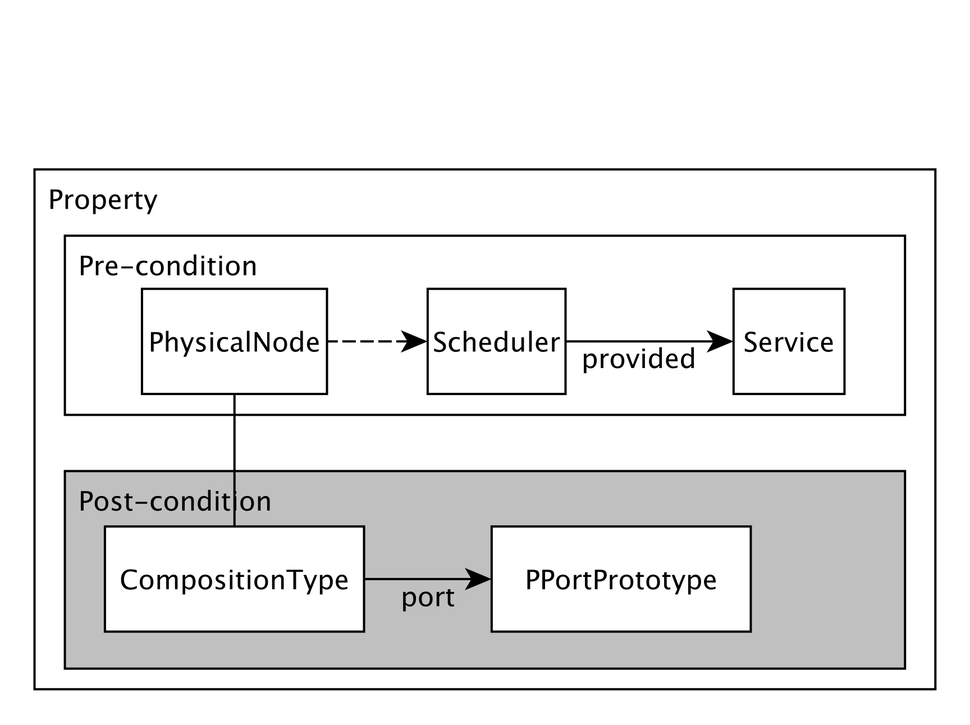
Example property [4]
P1: “If a PhysicalNode is connected to a Service through the provided association (in the input), then
the corresponding CompositionType will be connected to a PPortPrototype (in the output).”
[4] G. Selim, L. Lúcio, J. R. Cordy, J. Dingel and B. Oakes. ” Specification and Verification of Graph-Based Model
Transformation Properties” ICGT 2014, York, UK. (LNCS)

Slide 9
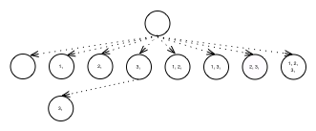
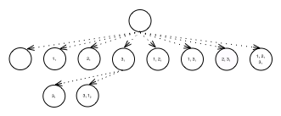
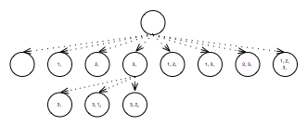
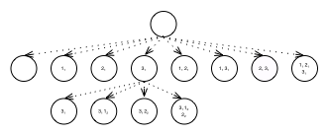
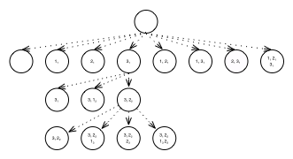
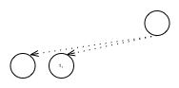
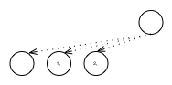
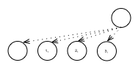
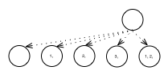
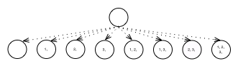

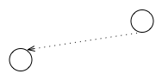
Path Condition Generation of DSLTrans Model Transformations [5,6]
Process
Layer 1
1₁
2₁
3₁
Process
Layer 2
…
…
Process
Layer 3
Unfeasible
Control Path
1₂
2₂
Path Conditions
2₃
2₃
[5] L. Lúcio, B. Barroca, V. Amaral “A Technique for the Verification of Model Transformations” Proceedings of MoDELS, 2010.
[6] A Technique for Symbolically Verifying Properties of Graph-Based
Model Transformations, L. Lúcio, B. Oakes and H. Vangheluwe.
Technical Report SOCS-TR-2014.1, McGill University, 2014.
Notes:
Mention why certain control paths are infeasible
Backward links do not exist the the path conditions built so far
Very abstract view, see my poster for the details of the symbolic execution

Slide 10
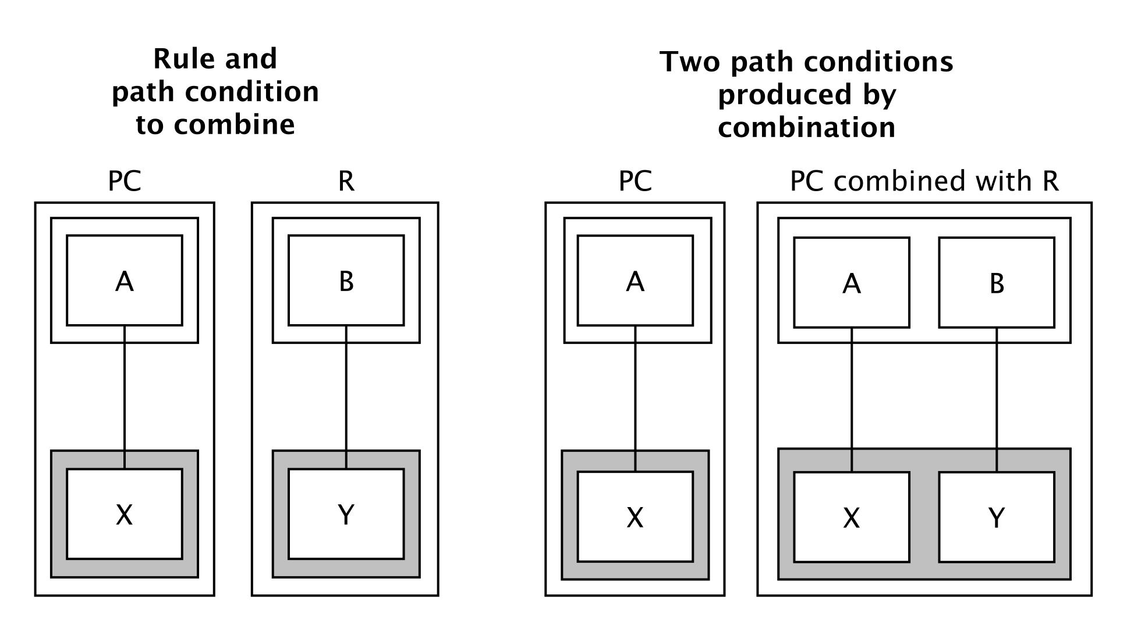
Case 1: Rule has no Dependencies

Slide 11
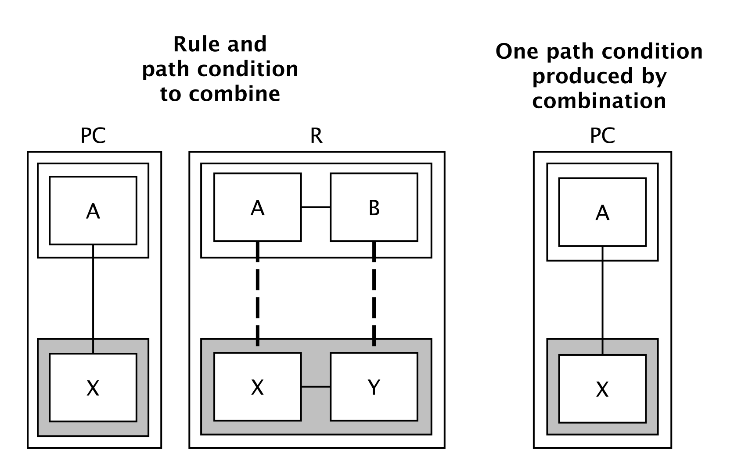
Case 2: Rule’s Dependencies are not Satisfied by the Path Condition

Slide 12
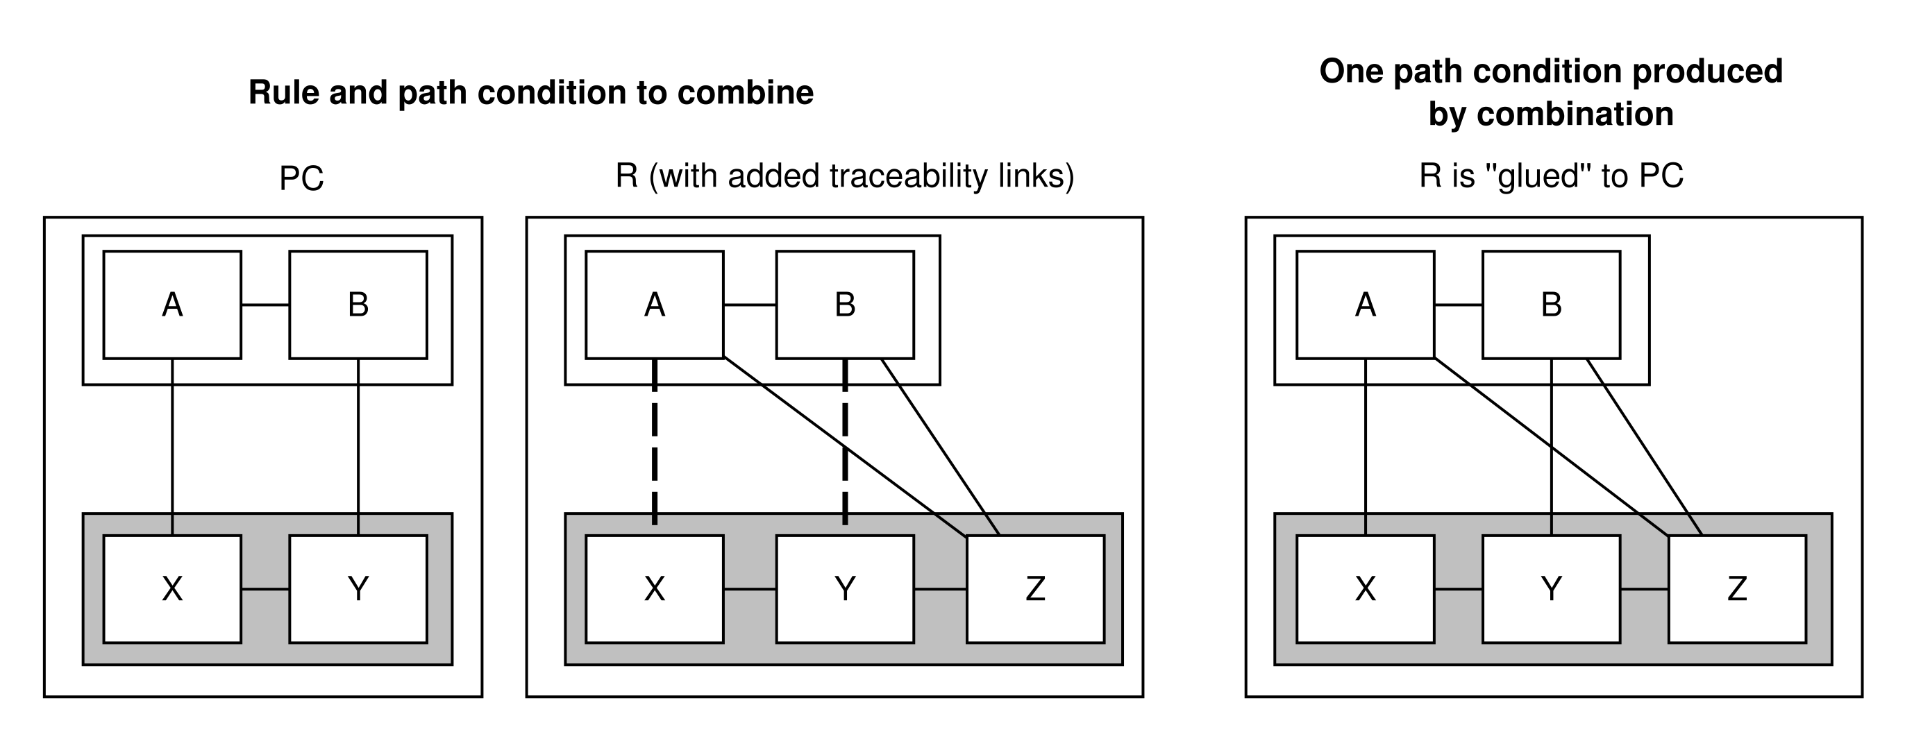
Case 3: Totally- and Partially- Satisfied Dependencies

Slide 13
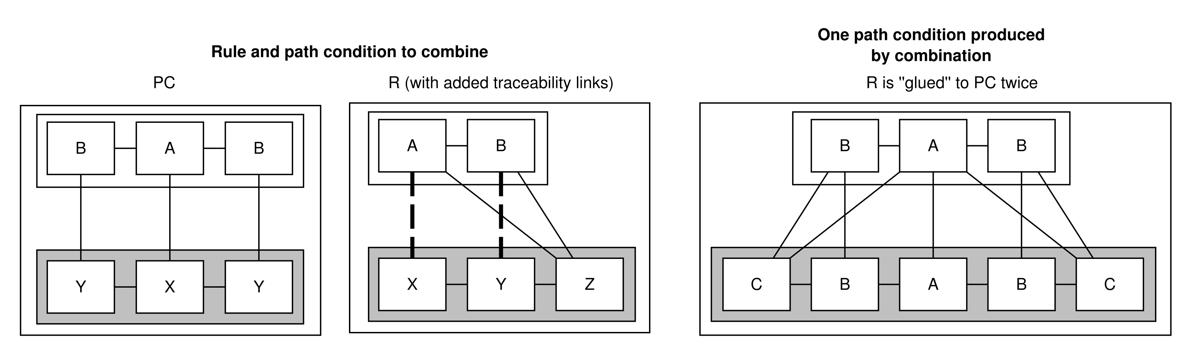
Case 3: Totally- and Partially- Satisfied Dependencies

Slide 14
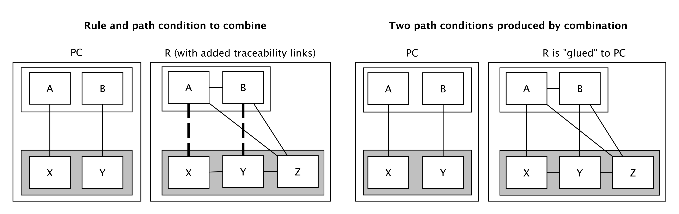
Case 3: Totally- and Partially- Satisfied Dependencies

Slide 15
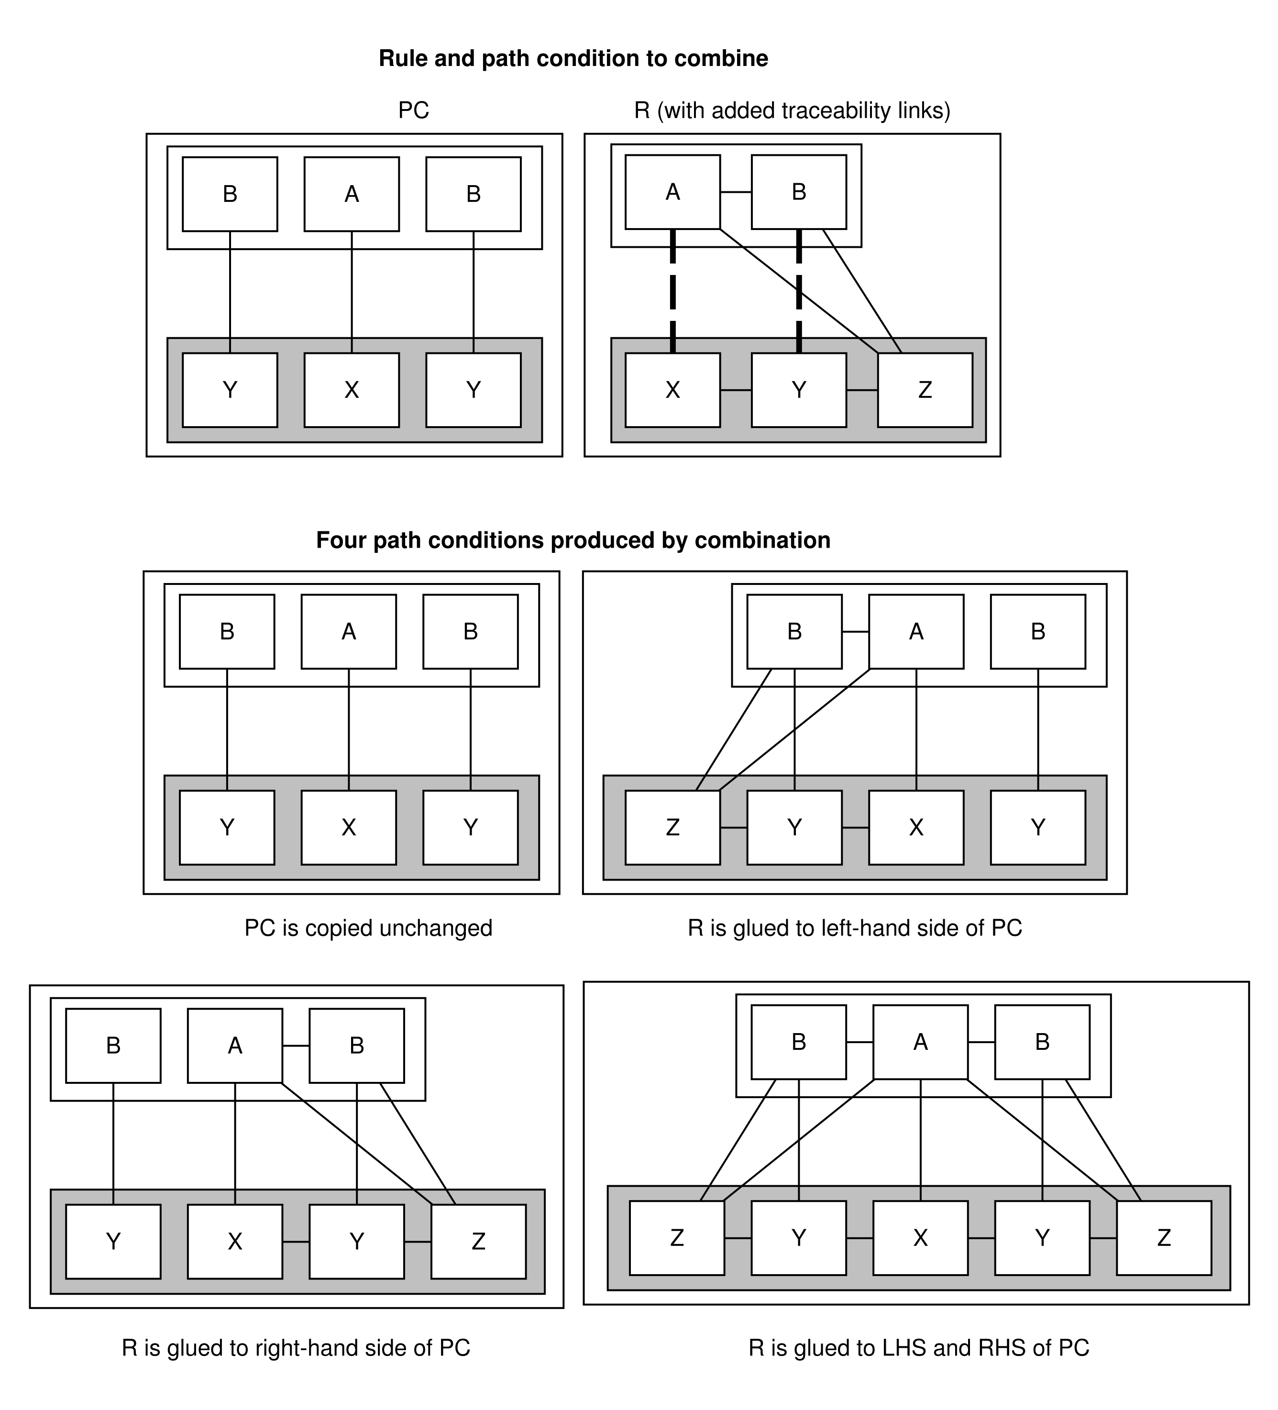

Slide 16
Proving Properties
A property is does not hold for a path condition pc whenever its pre-condition is found on pc, but its post-condition is not. Otherwise we say the property holds for pc.
A property is holds for a transformation whenever it holds for all of the transformation’s path conditions.

Slide 17
Properties of Property Proving [7]
Validity
Theorem: the result of proving a property for all path conditions generated for a transformation or an all executions of that transformation is the same
Completeness
Theorem: properties of a transformation can be shown to either hold for all transformation executions, or not hold for at least one transformation execution
[7] L. Lúcio, B. Oakes, H. Vangheluwe “A Technique for Symbolically Verifying Properties of Graph-Based Model Transformations”. Technical Report SOCS-TR-2014.1, McGill University, 2014.
Notes:
Talk about abstraction relation here

Slide 18

Implementation
Principle:
Development of the tool should be model-driven (as much as as possible)
“Eat your own dog food!”
First class citizens:
Metamodels
Models
(Higher-Order) Model Transformations

Slide 19



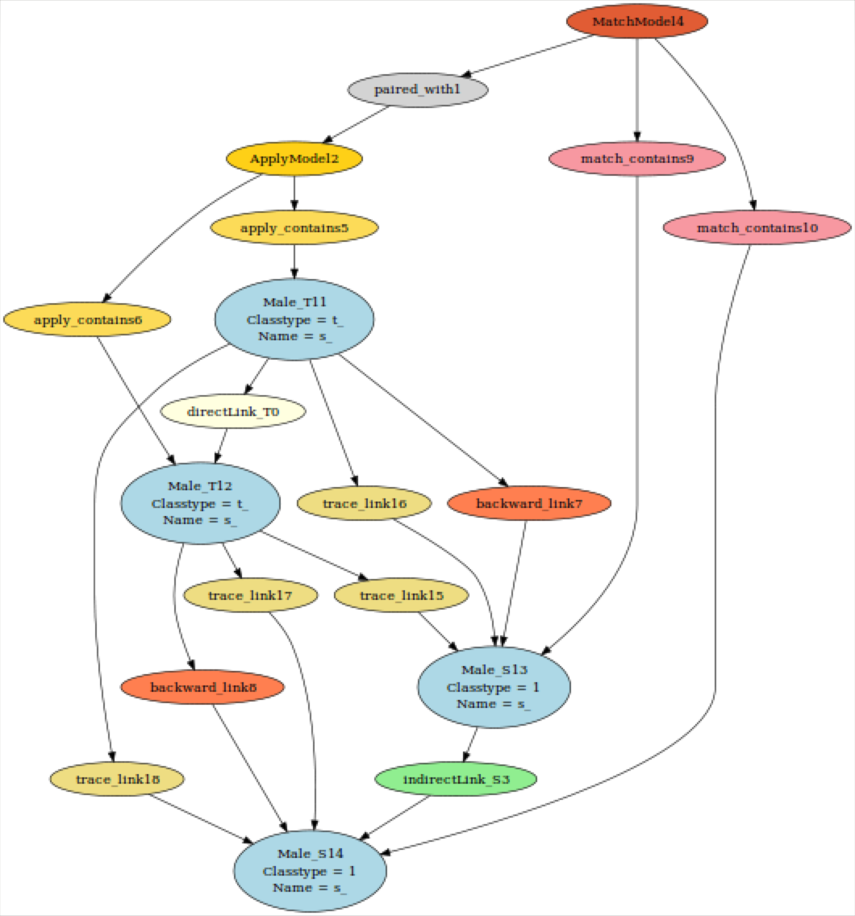
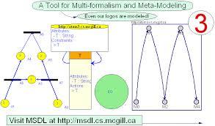







Tooling and developers
T-Core
igraph / Himesis
Levi Lucio
McGill U.
Bentley Oakes
McGill U.
Gehan Selim
Queen’s U.
Cláudio Gomes
Antwerp U.

Slide 20
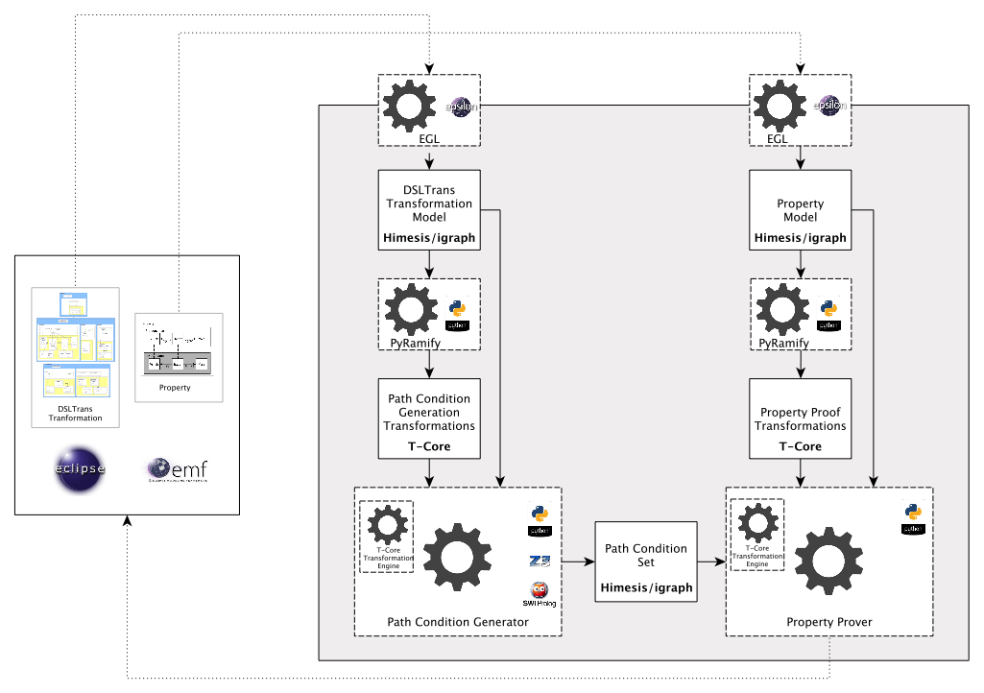
Tool Architecture

Slide 21
Model-Driven Development: Challenges
Challenges
Insufficient higher-order model transformation technology (AToM3) models are not built for memory-intensive applications Transformations and code have to be developed together in an interleaved fashion

Slide 22
Model-Driven Development: Advantages
Advantages
(Surprisingly) speed! Adapted to the domain Models simplify the usage of complex data types

Slide 23
Model-Driven Development: Ambivalent
Ambivalent
Right level of abstraction through the usage of metamodels and model transformations Visual edition and debugging of metamodels, models and model transformations

Slide 24
Case Studies
Case study 1: GM To Autosar
Partial migration transformation from the proprietary VCS architecture language for automotive hardware and software deployment into AUTOSAR.
Small subset of the complete metamodel, for experimentation.
Case study 2: UML-RT To Kiltera
Give semantics to UML-RT in terms of the CSP-like language Kiltera, for simulation.
Functional half the UML-RT metamodel is transformed.
Case study 3: mbeddr to C
Give semantics to specifications in the mbeddr language as C code, for execution.
Complete subset of the mbeddr metamodel required for the transformation of connectors between mbeddr components into C function calls.
To prove the property: “for every invocation of a function on an instance of a component by an instance of a another component, via a connector, the correct C function generated by the transformation is called”.

Slide 25
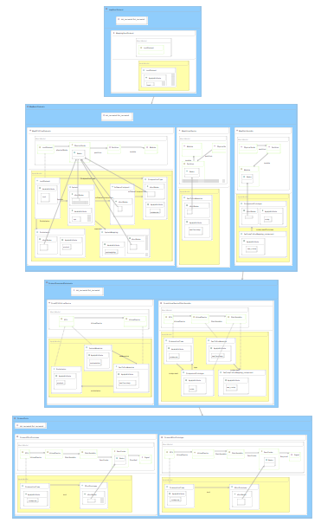
Case study 1: GM To Autosar
Number of rules: 8
Number of layers: 4
Symbolic execution time: 0.6 s
Number of path conditions: 3
Property proving times: 0.02 s on average

Slide 26
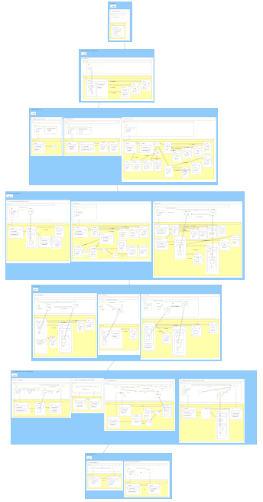
Case study 2: UML-RT to Kiltera
Number of rules: 17
Number of layers: 7
Symbolic execution time: 80 s
Number of path conditions: 330
Property proving times: tens of seconds
Required implementation of the symbolic execution
of conditions on object attributes!

Slide 27
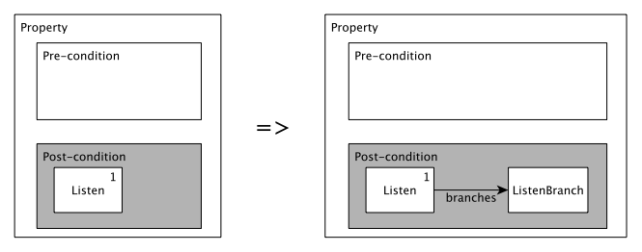
Demo
If a Listen object is created, it must have at least one ListenBranch object. A Listen object represents a Listener process that awaits input on one or more channels. If we have a Listen object, then we are awaiting input on at least one channel (ListenBranch).

Slide 28
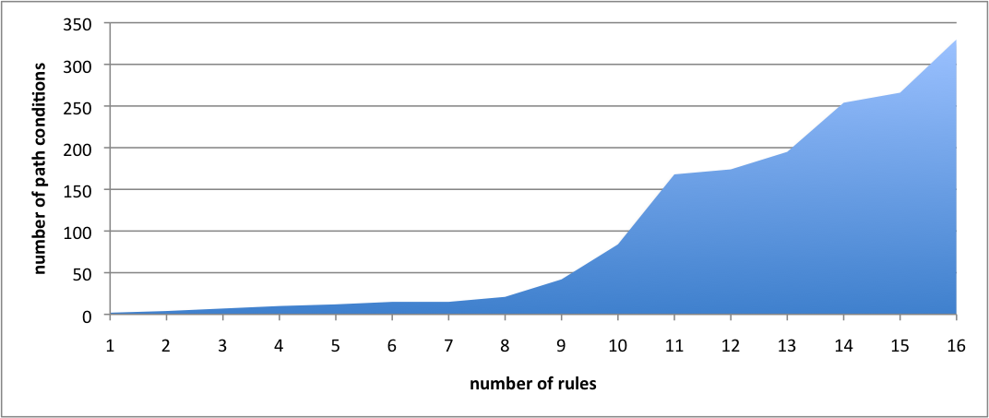
UML-RT to Kiltera: rules vs path conditions

Slide 29
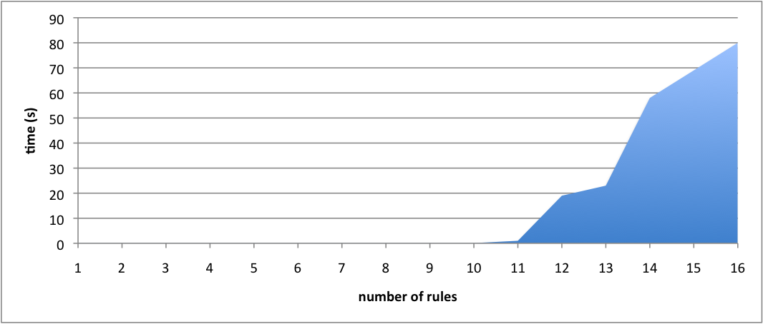
UML-RT to Kiltera: rules vs time

Slide 30
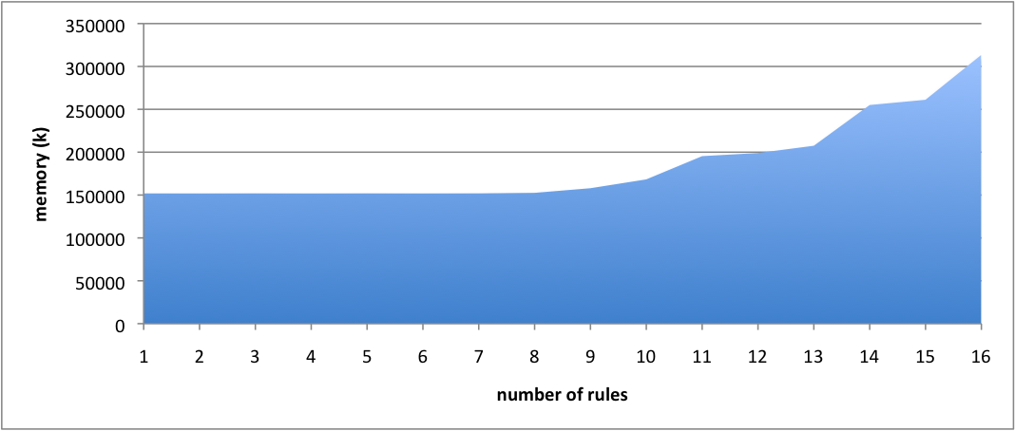
UML-RT to Kiltera: rules vs space

Slide 31
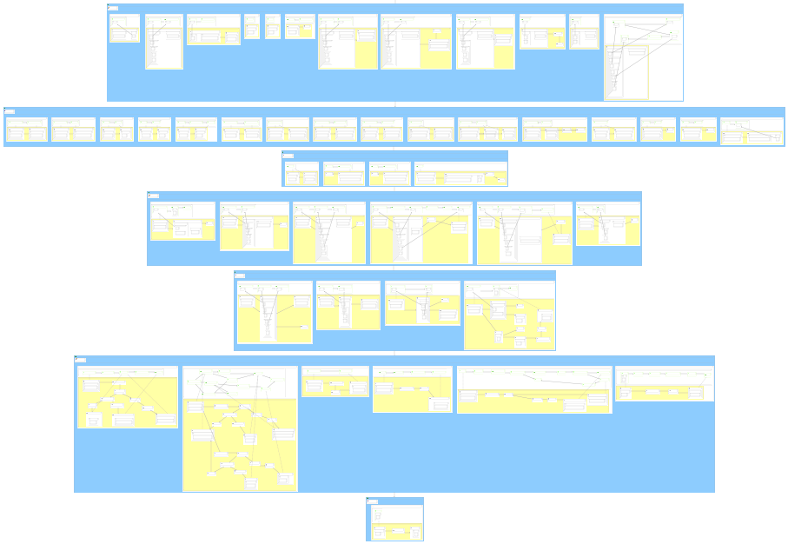
Case study 3: mbeddr to C
Number of rules: 49
Number of layers: 7
Symbolic execution time: 1264 s (23 rules)
Number of path conditions: ?
Property proving times: ?

Slide 32
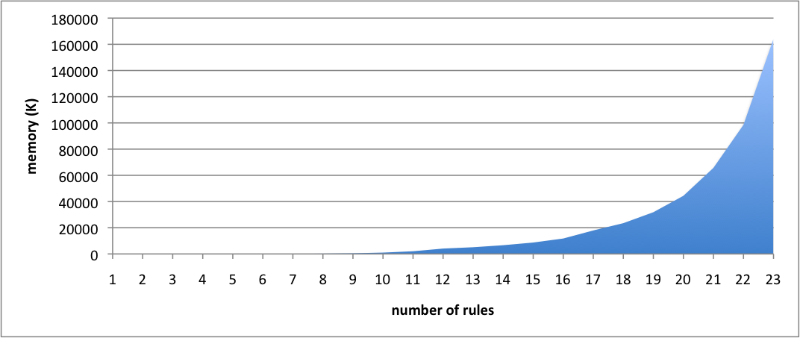
mbeddr to C: rules vs path conditions

Slide 33
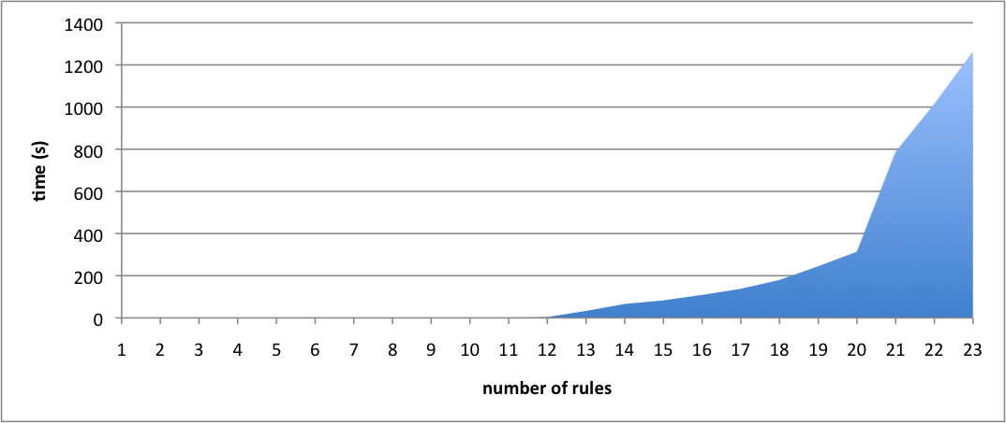
mbeddr to C: rules vs time

Slide 34
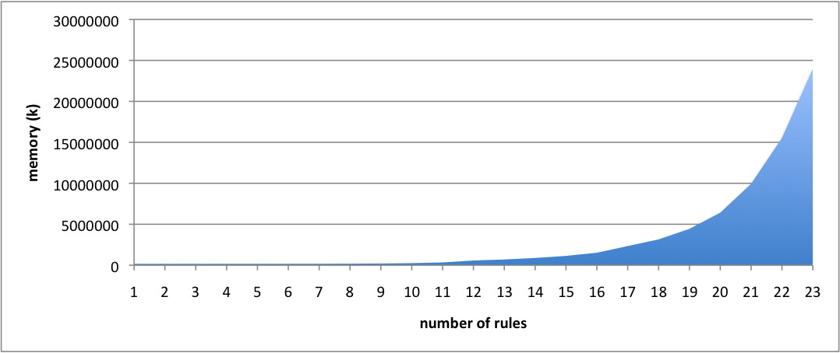
mbeddr to C: rules vs space

Slide 35
Challenges
Scalability of the tool
Memory is the current limitation
What is the best solution for trading speed for memory?
Theory
Right abstraction level to explain soundness and completeness
Including NACs in the theory

